Slide 1
INVESTMENT CASE STUDY SUBMISSION
Group Name:
Hemant Satam

Slide 2
<Abstract>
Overview
Spark Funds is an asset management company
Spark Funds want to make investments in a few companies
CEO of Spark funds wants to understand the global trends in investments in order to take effective decisions
Constraints
Spark funds to invest between 5 to 15 million USD per round of investment
Spark funds want to invest only in English-speaking countries for ease of communications with companies it invests in
Strategy
Spark Funds wants to invest in where most other investors are investing

Slide 3
<Problem solving methodology>
Investment type Analysis
Compare typical investment amounts in a venture, seed, angel and private equity
Enable Spark fund to choose the investment type that is best suited for their strategy
Country Analysis
Identify countries which have been most heavily invested in the past
Countries identified has to be English Speaking countries (manually identified)
Sector Analysis
Understand the distribution of investments across eight sectors
Suggest top 3 sectors in which 3 identified countries have maximum investment

Slide 4
<Analysis>
Data available for companies [permalink] and round2 [company_permalink] needs cleansing prior to usage
Difference found in two datasets of 2 records, which has been ignored given the large number of records available for analysis
Investment Amount [raised_amount_usd] contains null values – approach has been to be update these with 0’s for aggregation consistencies
Additional data found in round2 dataset to the tune of 42493 records that does not have a match in companies and hence removed (ignored for analysis)
A combined dataset of companies and round2 results in 114942 observations which have been further analysed to reach our conclusions

Slide 5
<Analysis>
Analysis based on investment type analysis
It has been observed that [seed] and [angel] investment type are way below and [private equity] investment type is way above the limit identified by Spark Funds of USD 5 – 15 Million
[Venture] investment type has been identified as the most suited investment type for Spark Funds as it fits within the range identified of USD 5 – 15 Million
Analysis based on country data (English speaking countries) indicate the following countries are best suited for investment by Spark Funds
USA (422.5 Billion)
GBR (20.24 Billion)
IND (14.39 Billion)

Slide 6
<Analysis>
Sector analysis indicates that maximum investments happen in the following sectors by country
[USA / GBR / IND] – Others
[USA / GBR ] - Cleantech / Semiconductors
[IND] - News, Search and Messaging
[USA / GBR / IND] - Social, Finance, Analytics, Advertising
Top two companies identified for each country with investments in top two sectors include
[USA] – social-finance and freescale
[GBR] – oneweb and immunocore
[IND] – flipkart and quikr-india

Slide 7
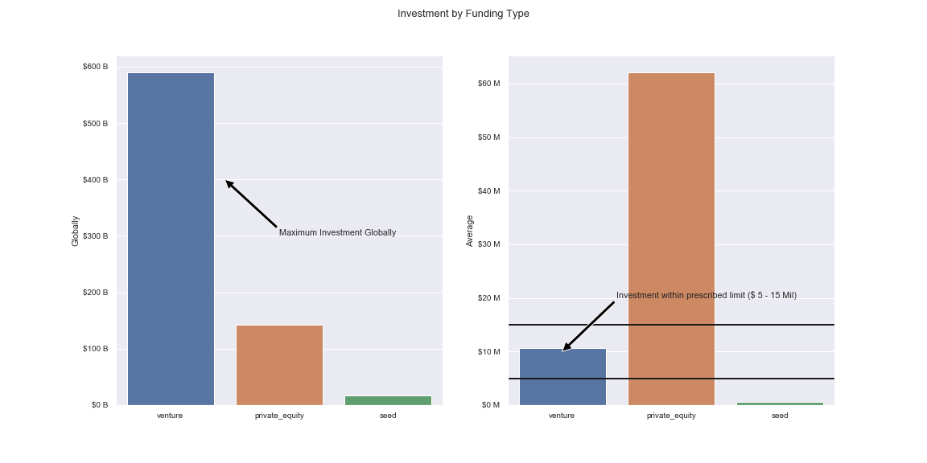
<Results – Investment by Funding Type>
Plot 1

Slide 8
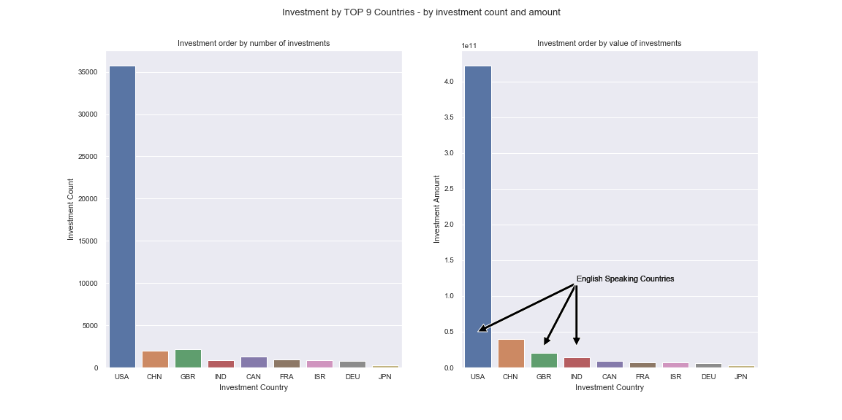
<Results – Investment by Top 9 Countries (by count and amount)>
Plot 2

Slide 9
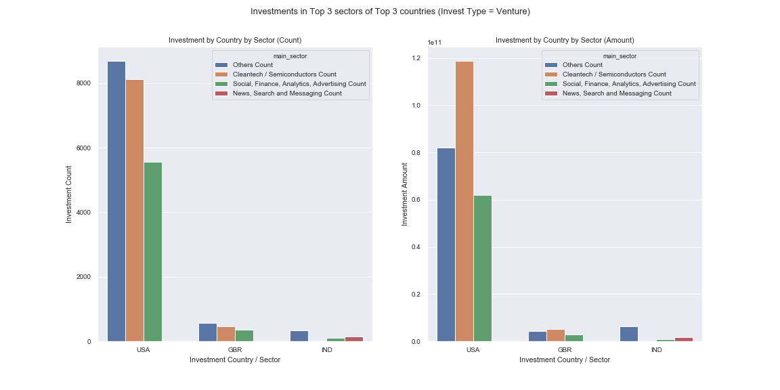
<Results – Investment in Top 3 Sectors of Top 3 Companies>
Plot 3

Slide 10
<Conclusions>
Spark Funds should invest in 3 English Speaking countries – USA, GBR and IND
Spark Funds should invest in top three sectors of these countries, which include;
[USA / GBR / IND] – Others
[USA / GBR] – Cleantech / Semiconductors
[IND] – News, Search and Messaging
[USA / GBR / IND] – Social, Finance, Analytics, Advertising
Spark Funds should invest in the following top two companies
[USA] – social-finance and freescale
[GBR] – oneweb and immunocore
[IND] – flipkart and quikr-india

